Slide 1
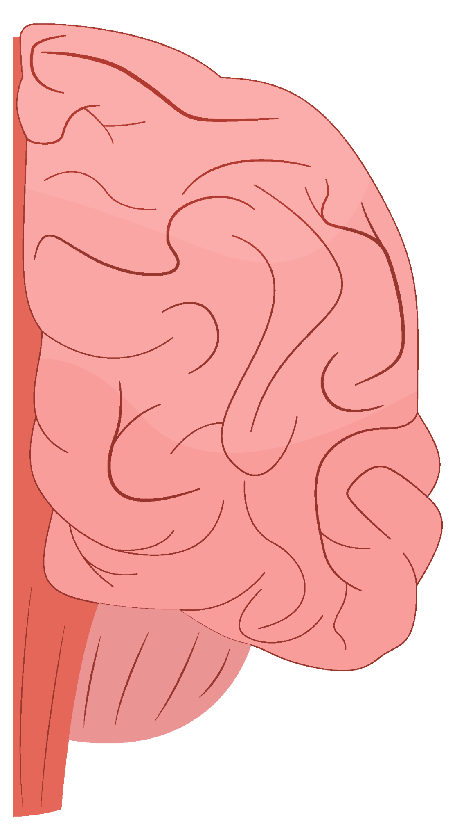
Stroke Risk Prediction Using Different Machine Learning Models.
Sondos Ameen Awad
211001732
Under the supervision of Dr. Muhammad El-sayeh

Slide 2
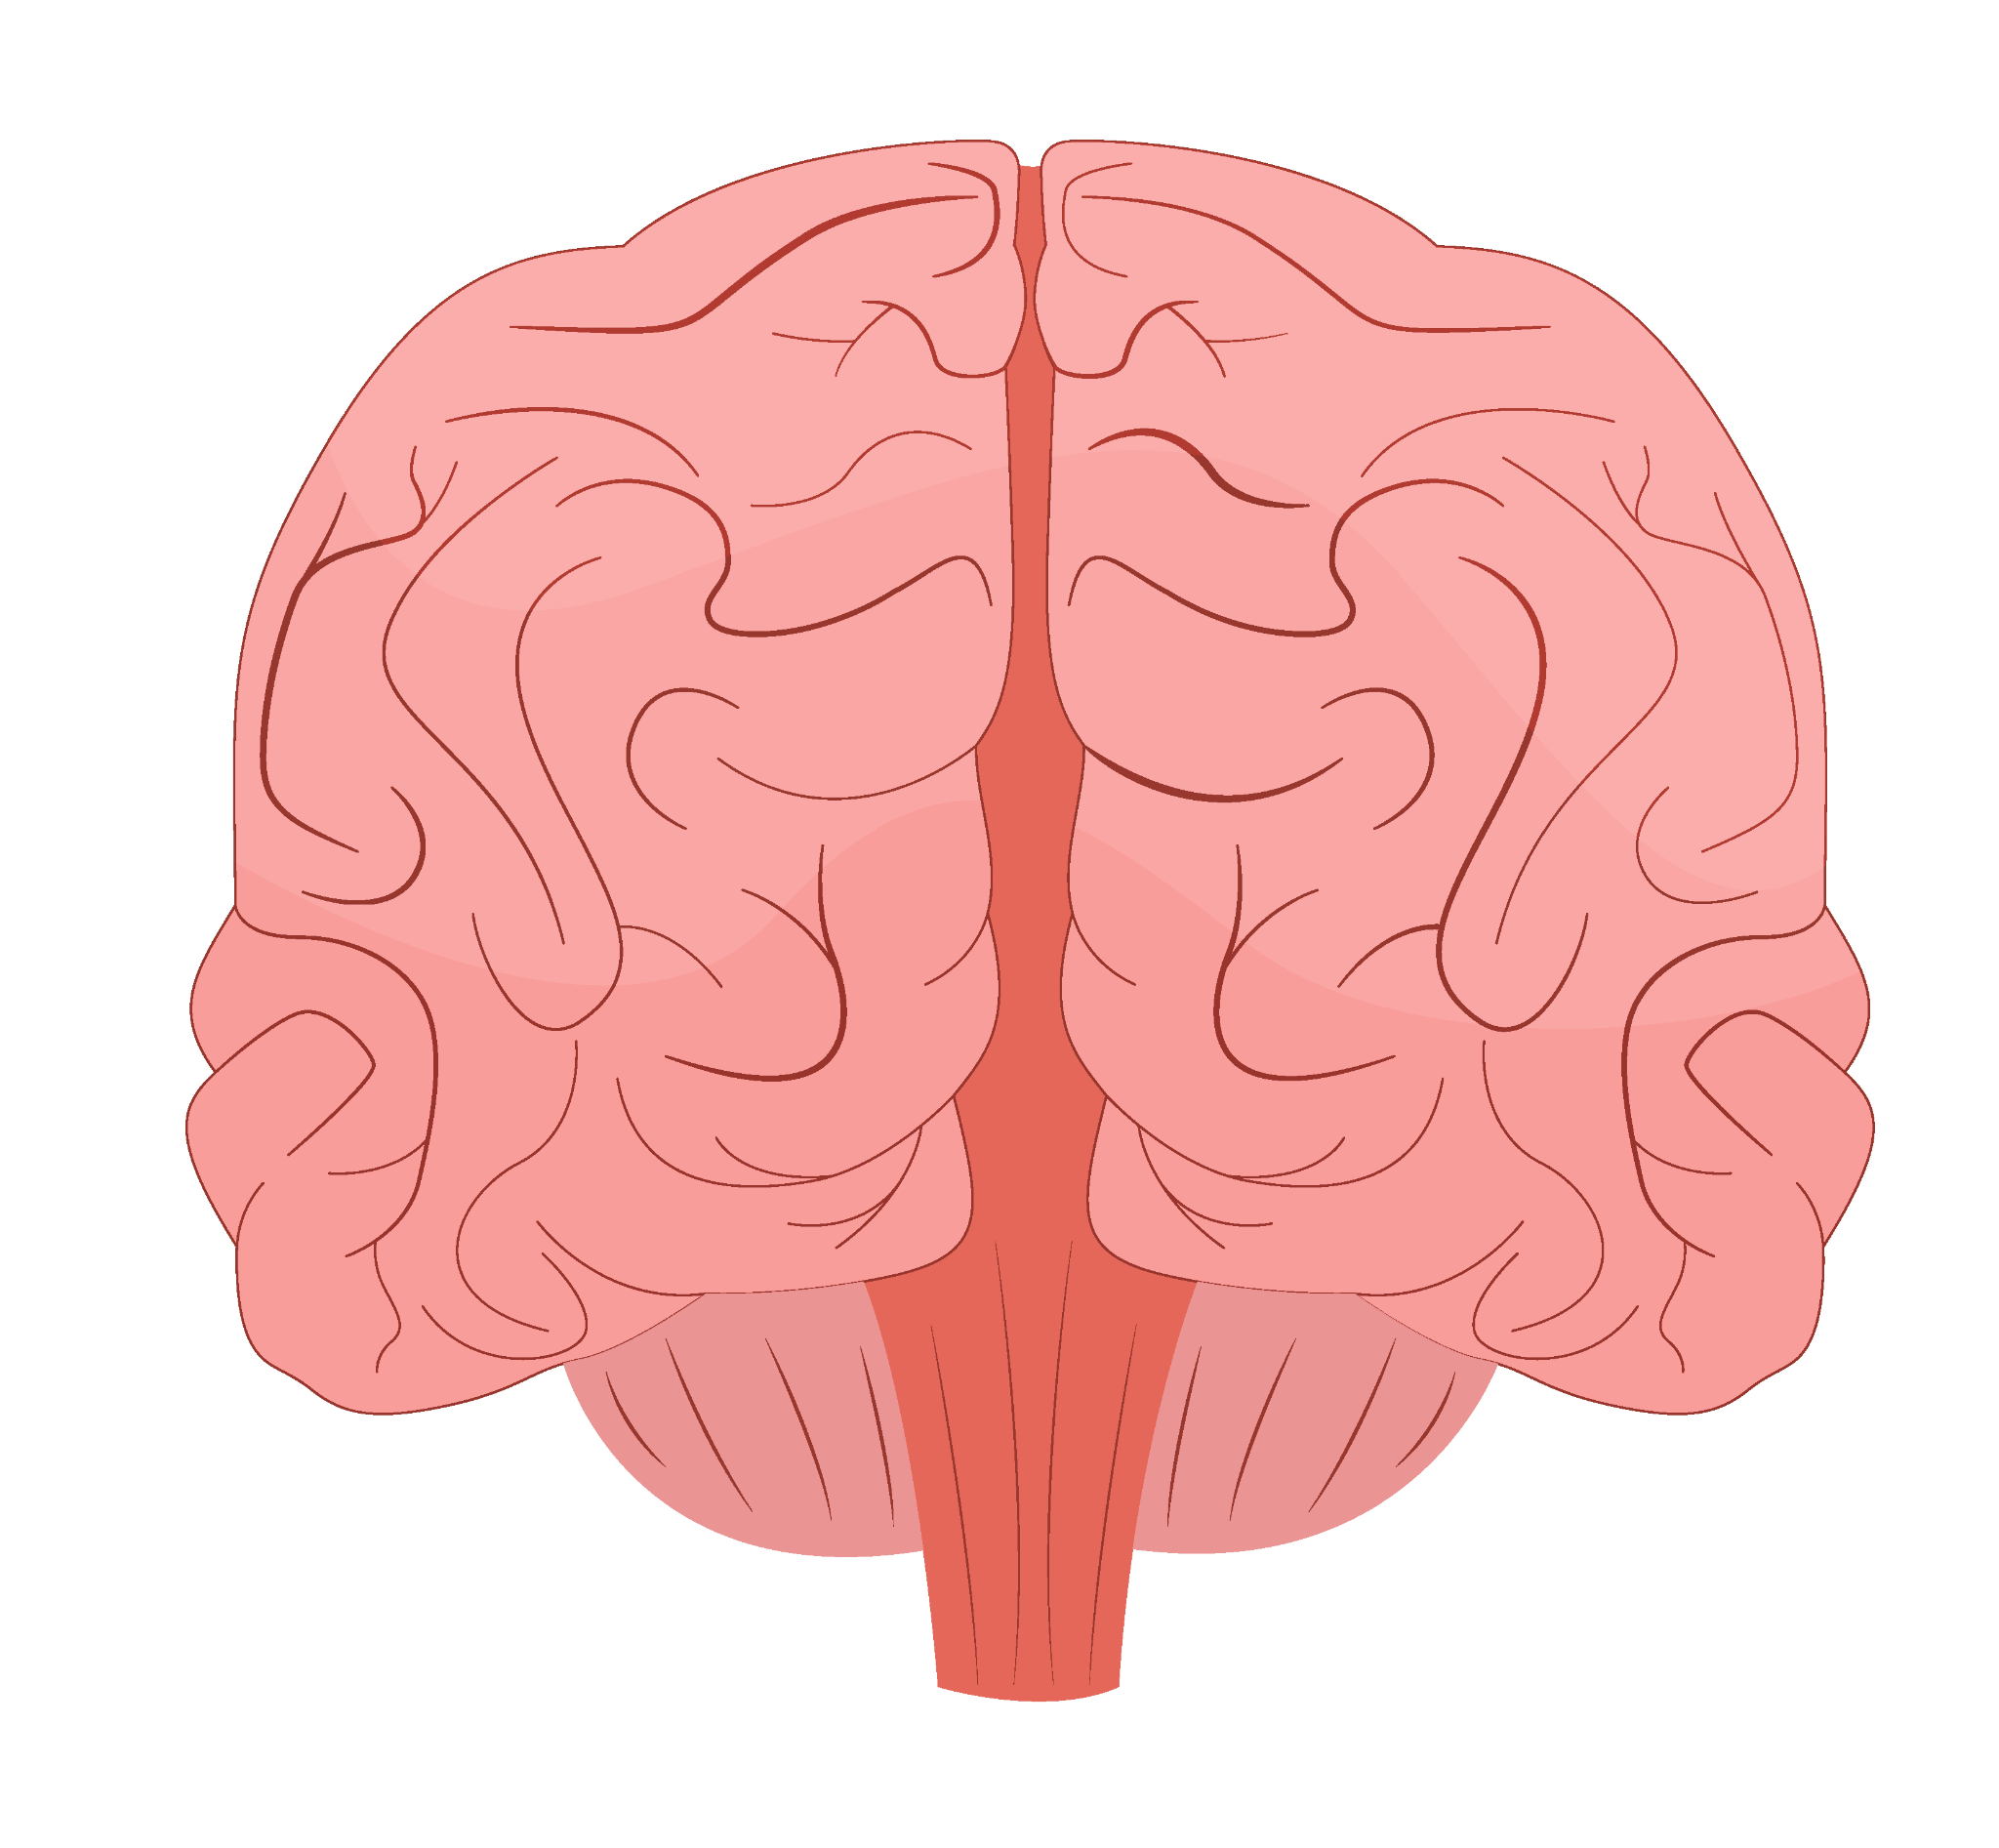
Table of contents
01
02
03
04
05
06
Introduction
Methodology
Results
Conclusion
Limitations
Recommendations

Slide 3
01
Introduction

Slide 4

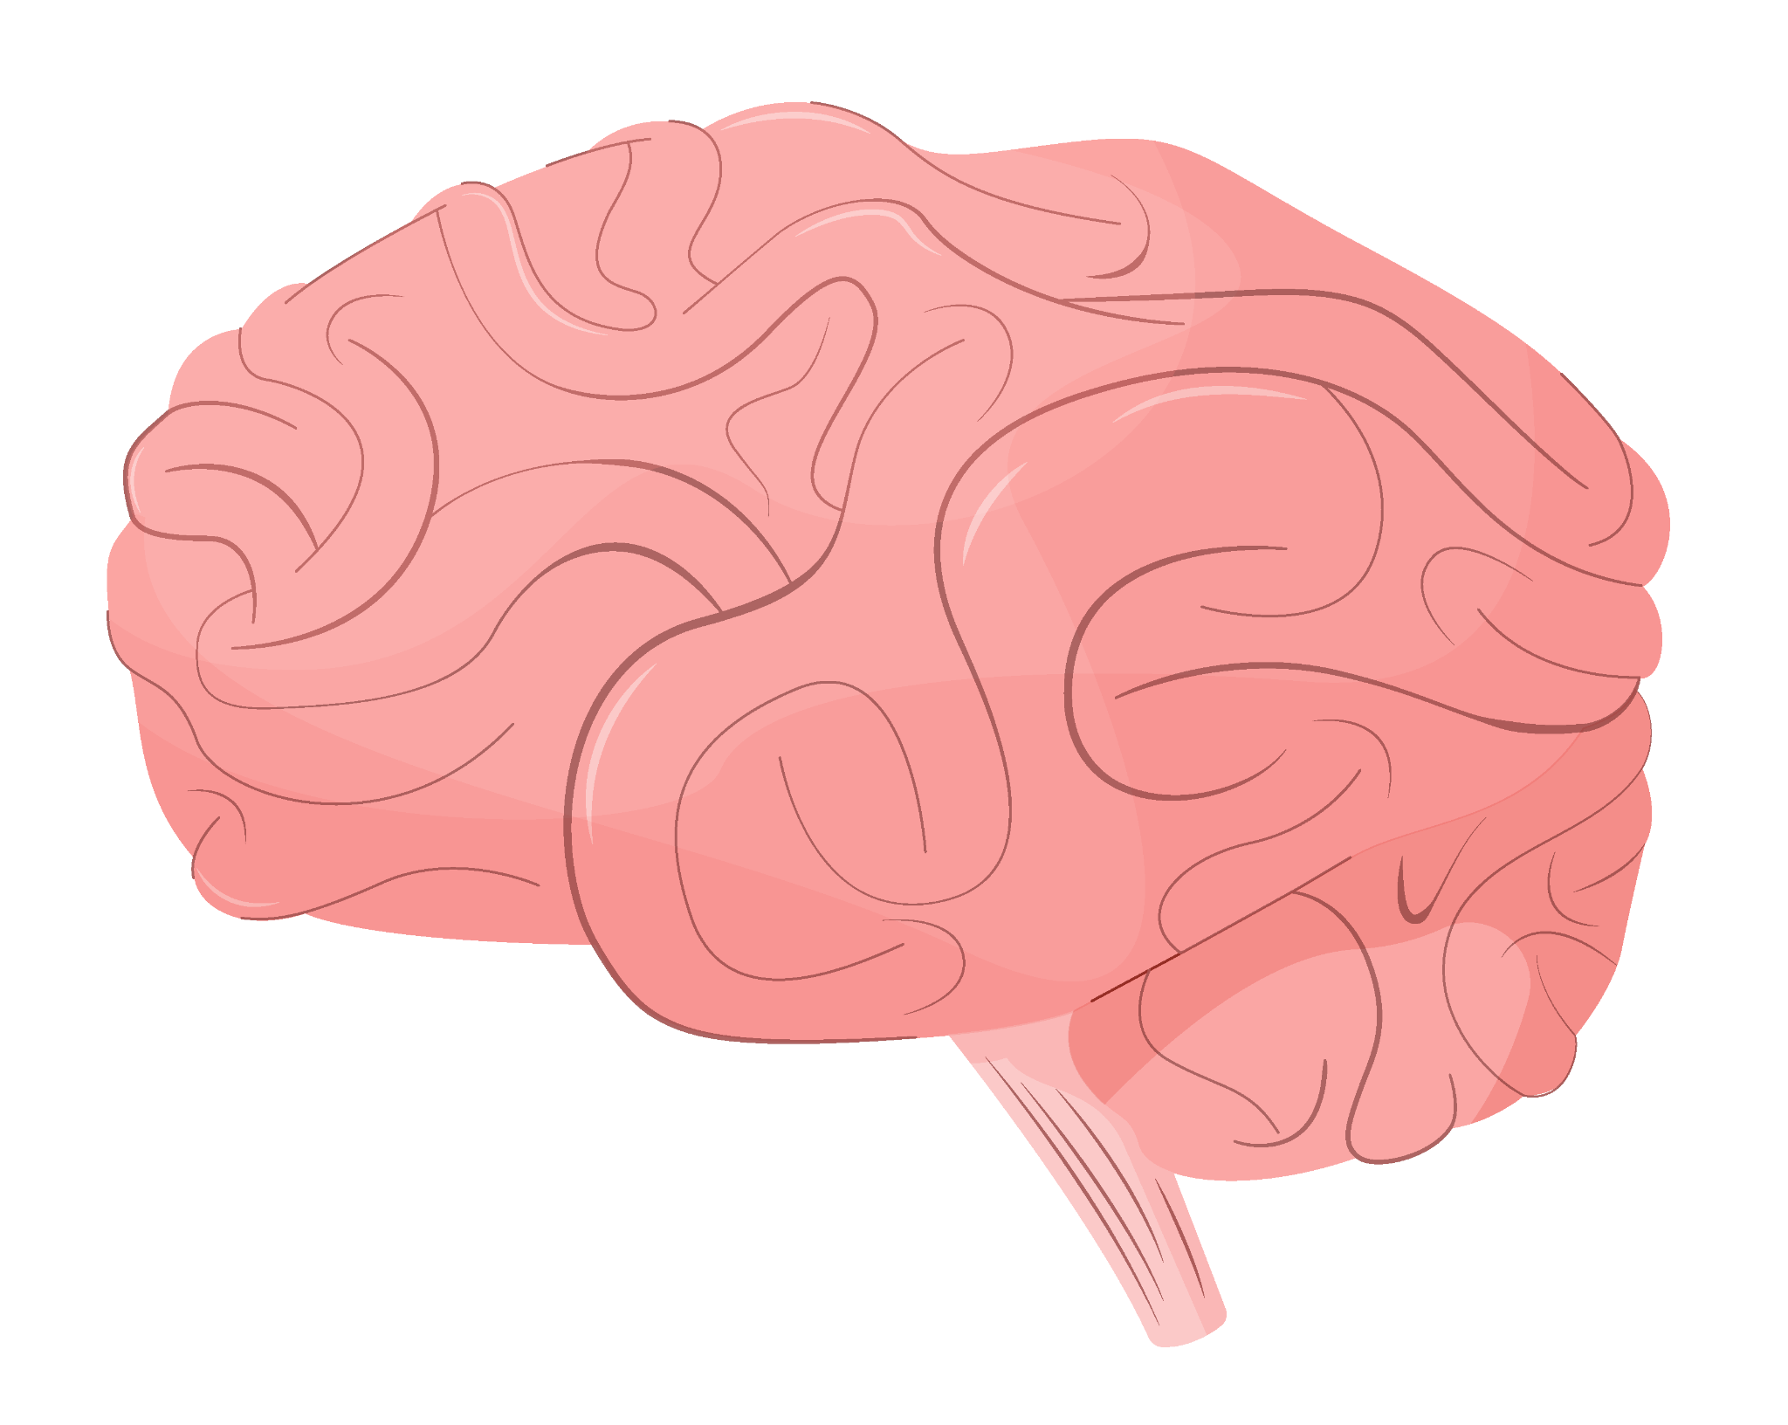
Strokes
13 million people experience a stroke each year.
Strokes are the largest cause of mortality and disability globally.
A stroke is an acute neurological condition caused by an interruption in blood flow to the brain, which deprives brain cells of oxygen

Slide 5
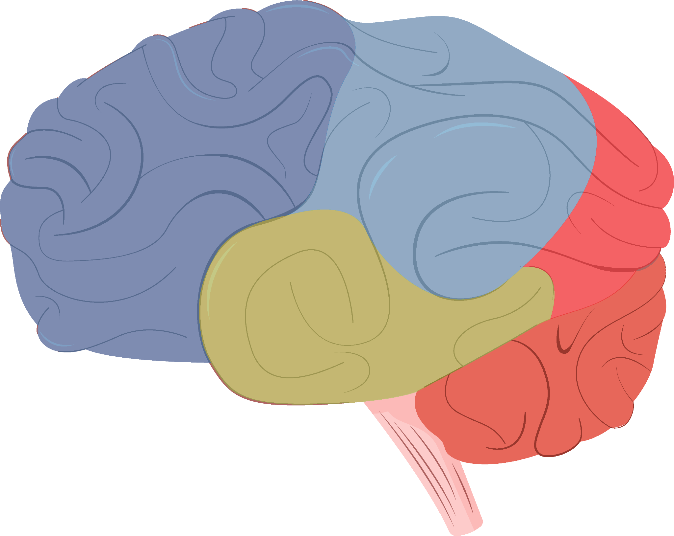
Aim
Develop and evaluate various machine learning (ML) models to create an accurate framework for predicting stroke occurrence over time.

Slide 6
Dataset Overview
ID | Refers to the participant’s ID.
Gender | Refers to the participant’s gender (Male, Female, others).
Age | Refers to the participant’s age in years.
Hypertension | Refers to whether the participant is hypertensive.
Heart diseases | Refers to whether the participant suffers from any heart diseases.
Ever married | Refers to the participant’s marital status.
Work type | Refers to the participant’s marital status.
Residence type | Refers to the participant’s residence status (urban, rural).
Average glucose level | Refers to the participant’s average glucose level.
BMI | Refers to the participant’s body mass index.
Smoking status | Refers to the participant's smoking status (never_smoked, formerly_smoked, smokes).
Stroke | Refers to the occurrence of stroke.

Slide 7
02
Methodology

Slide 8
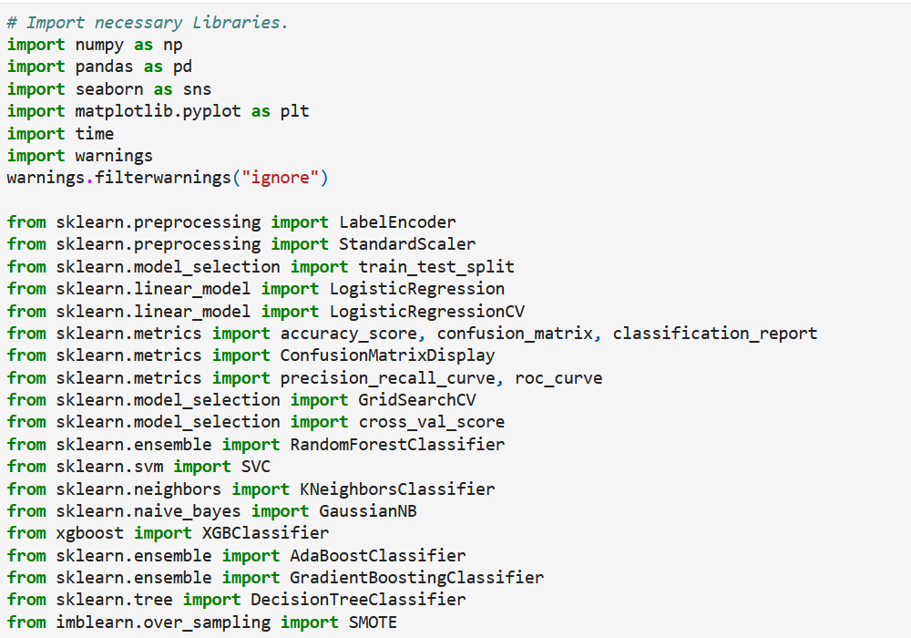
Importing Libraries

Slide 9
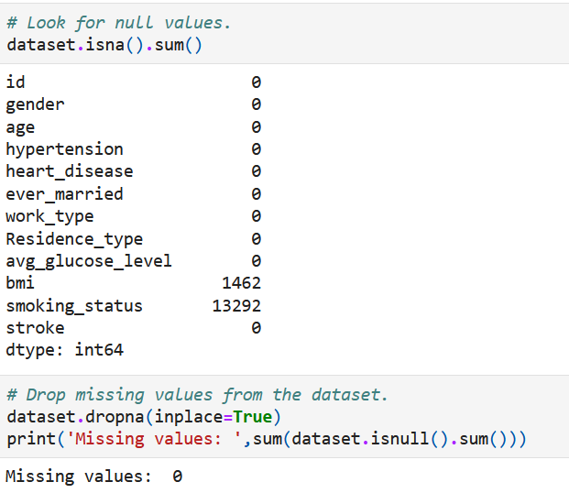
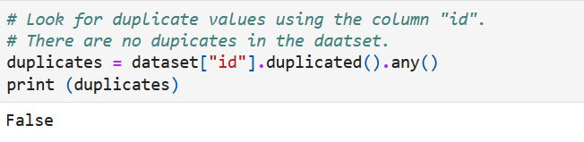
Data Preprocessing
Addressing null values.
Checking for Duplicates.

Slide 10
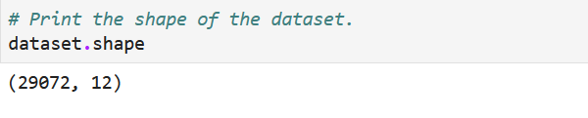
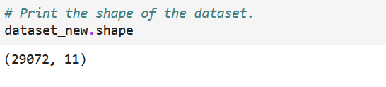
Data Preprocessing
Print dataset shape before dropping column.
Drop unnecessary columns.
Print dataset shape after dropping column.

Slide 11
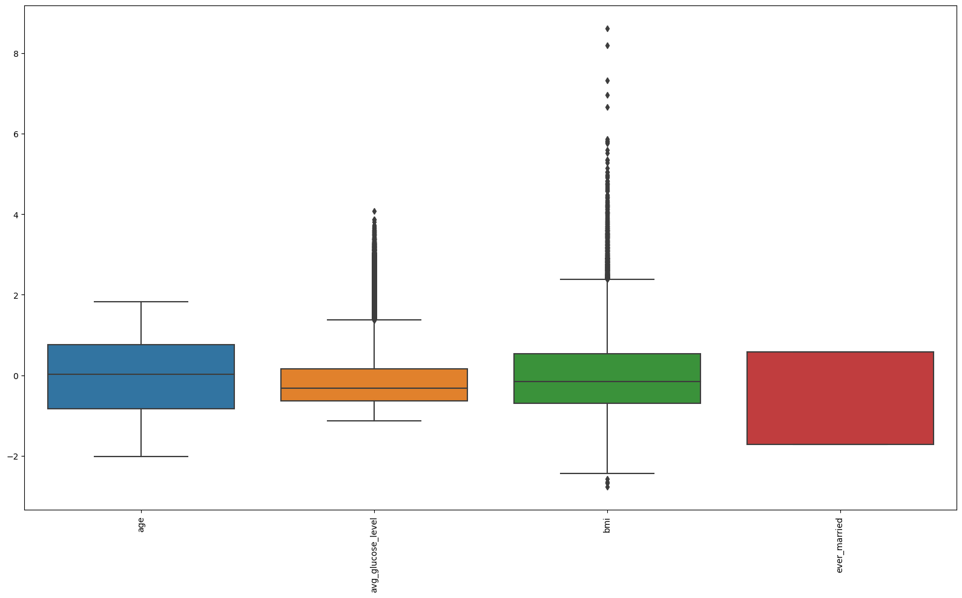
Data Preprocessing
Checking for outliers.

Slide 12
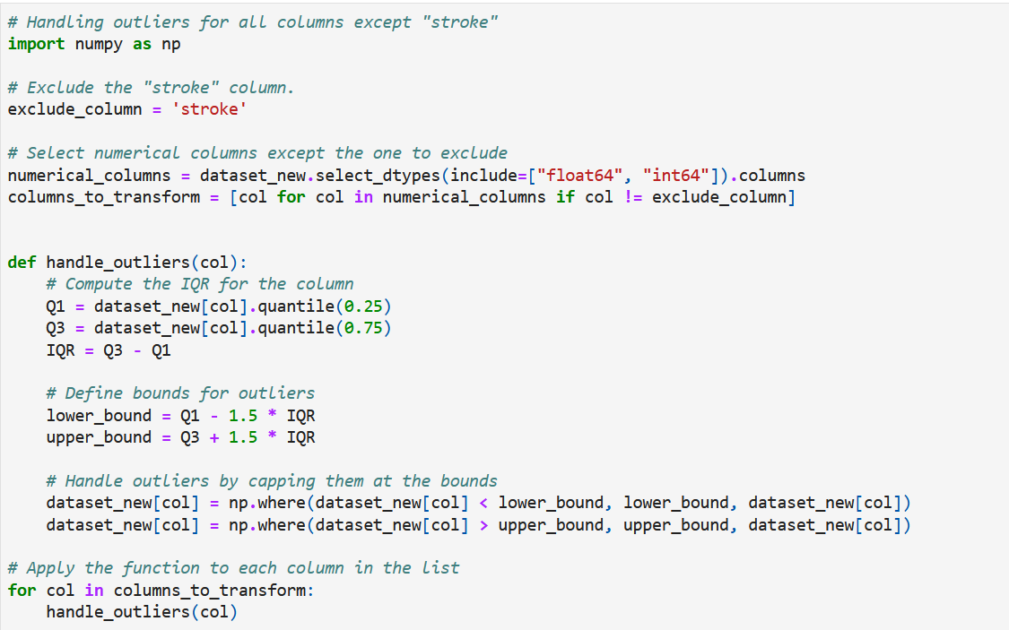
Data Preprocessing
Handling outliers.

Slide 13
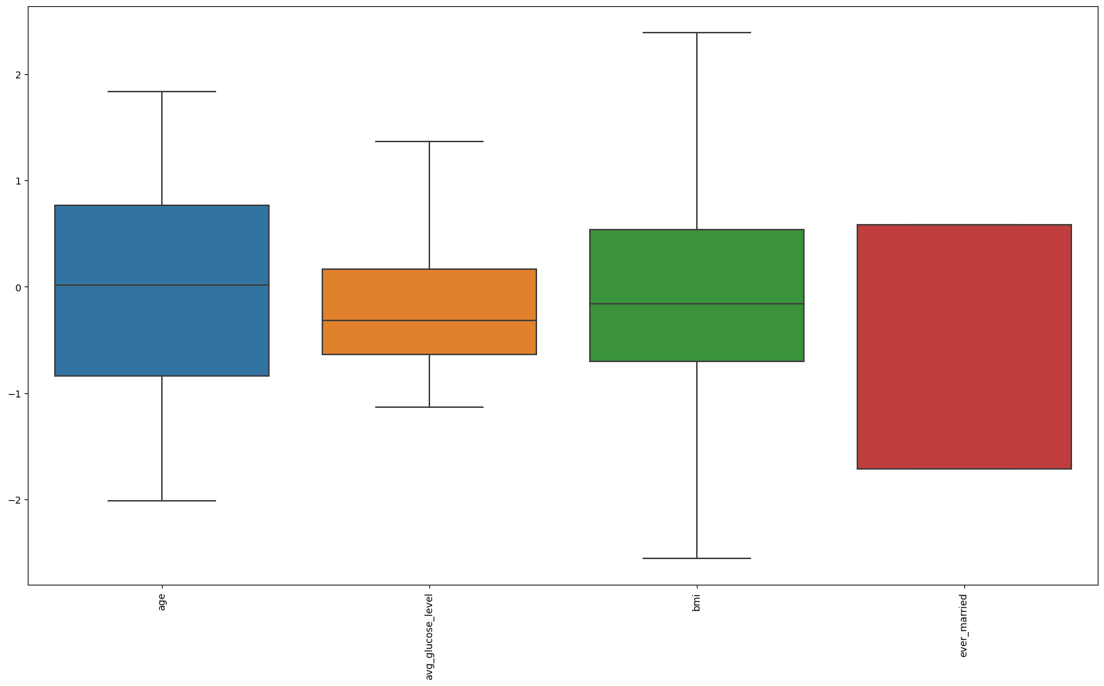
Data Preprocessing
Checking for outliers again.

Slide 14
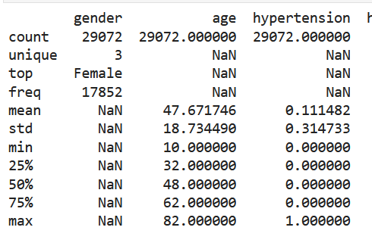
EDA
Describe the data.

Slide 15
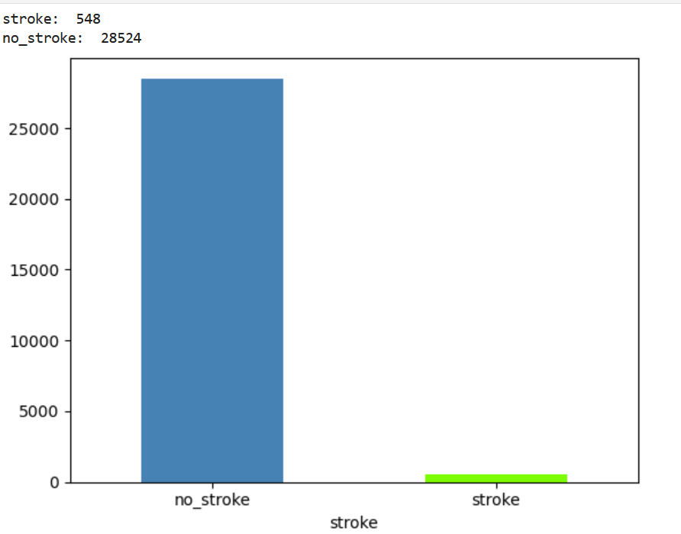
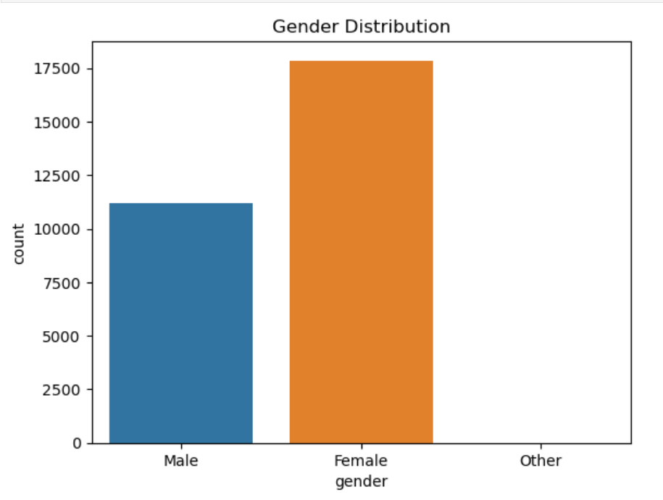
EDA
Visualizations.

Slide 16
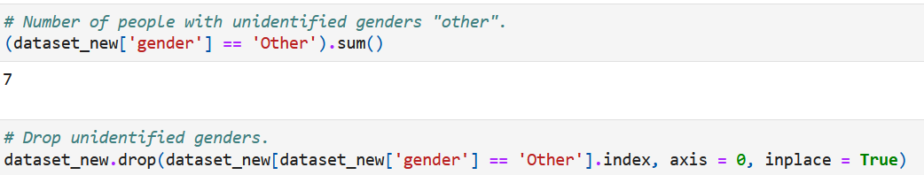
EDA
Drop “other” in gender column.

Slide 17
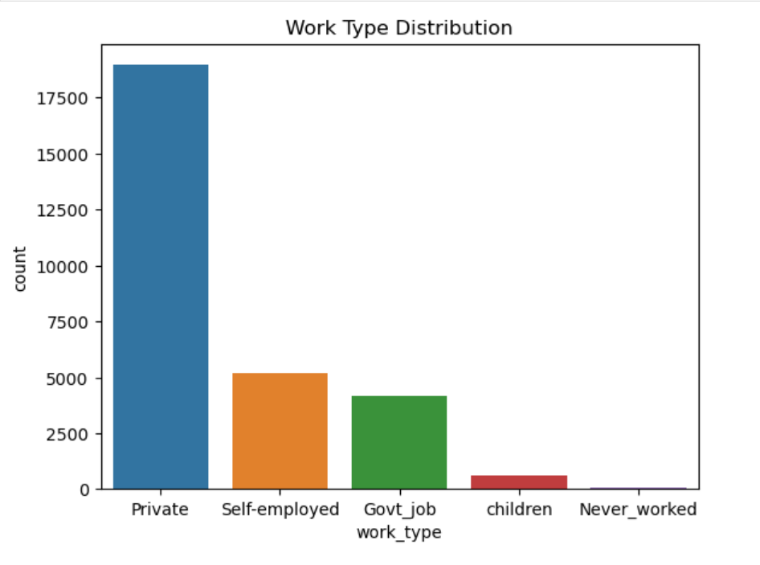
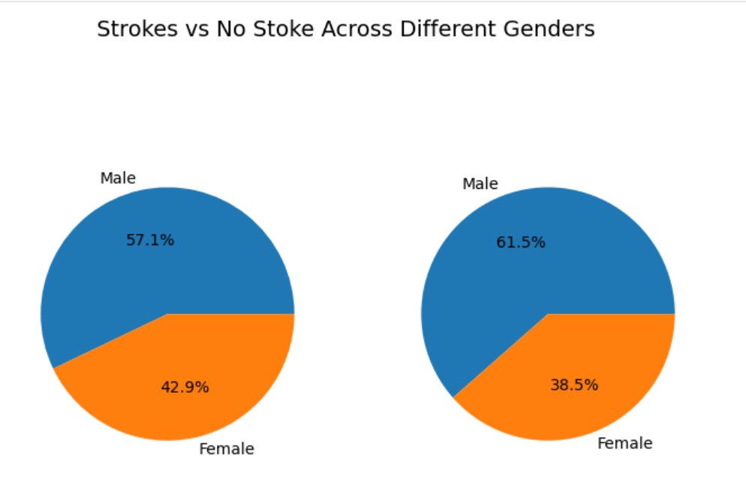
EDA
Visualizations.

Slide 18
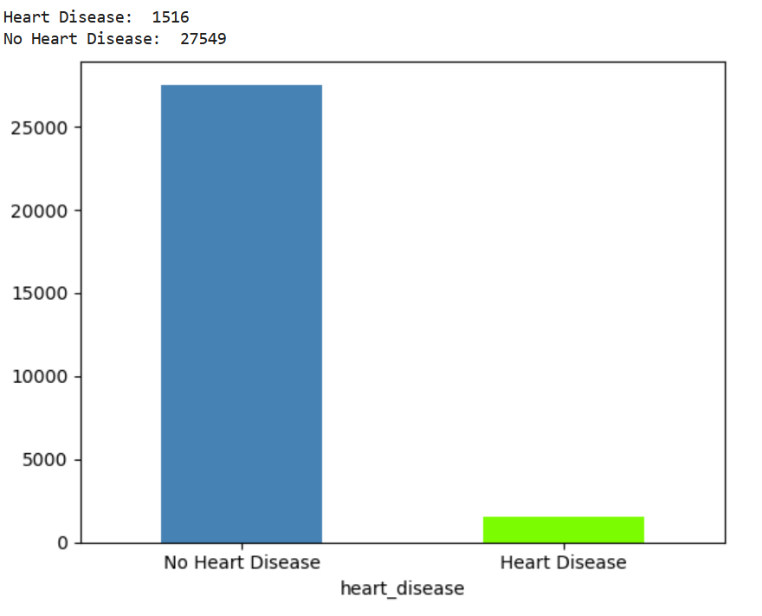
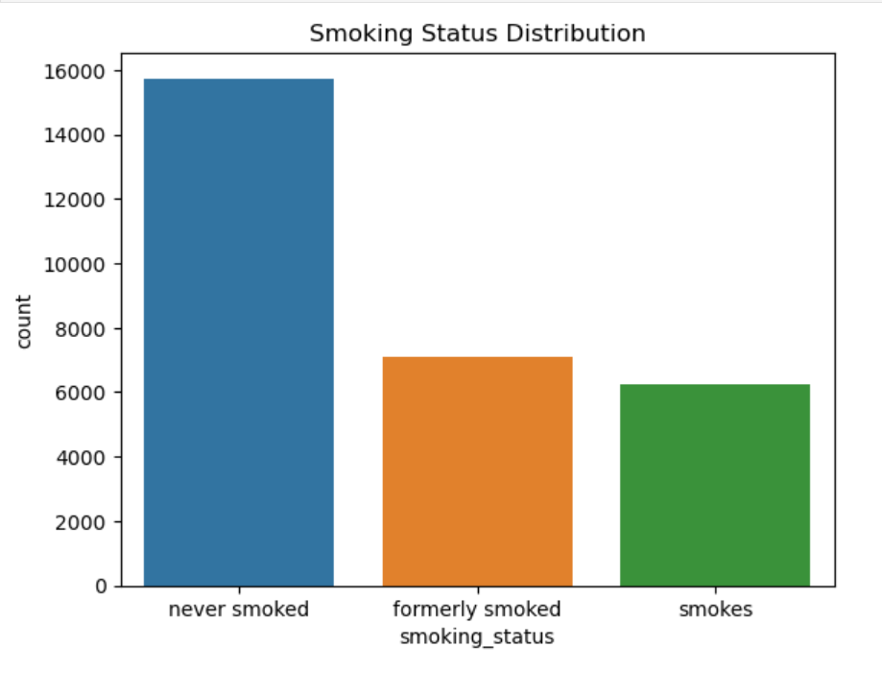
EDA
Visualizations.

Slide 19
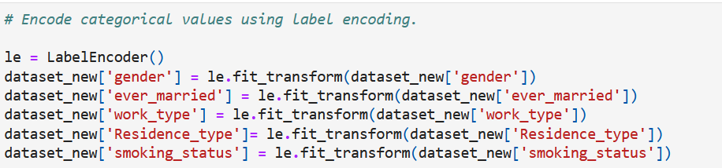
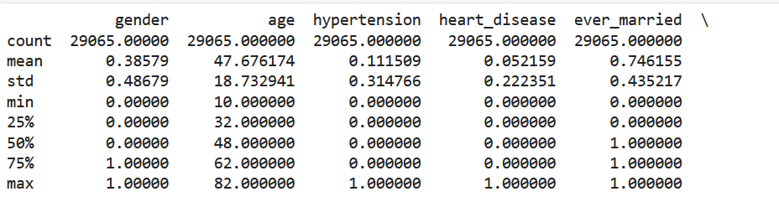
Feature Engineering
Label encoding.
Dataset description.

Slide 20
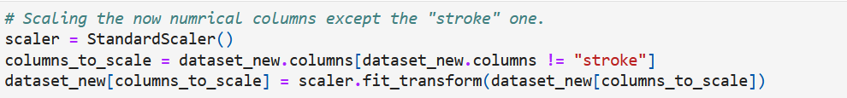
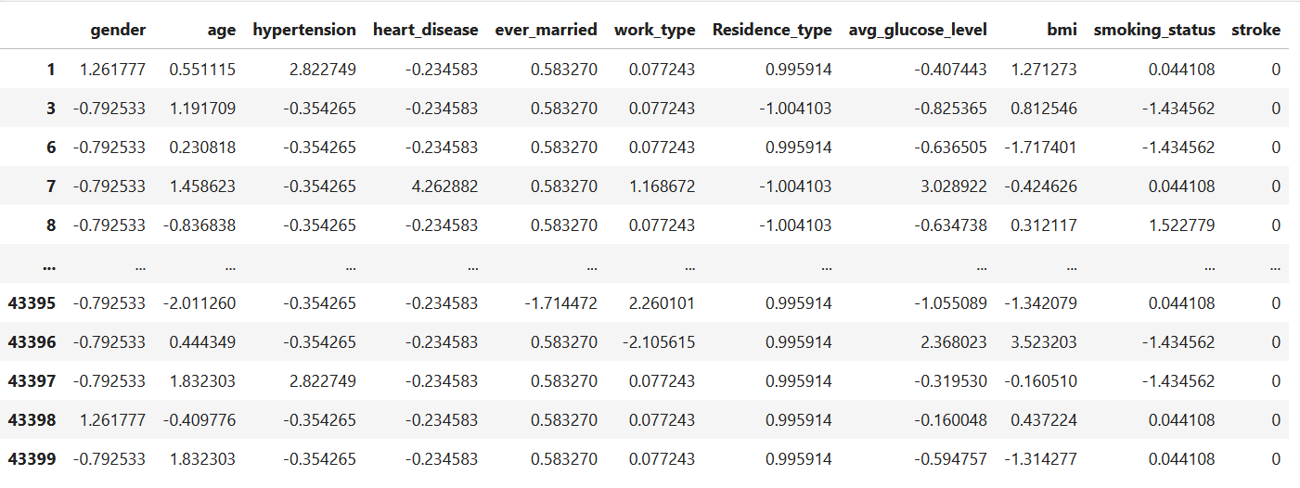
Feature Engineering
Data scaling.

Slide 21
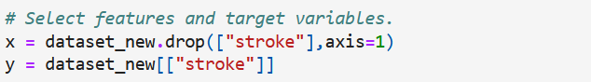
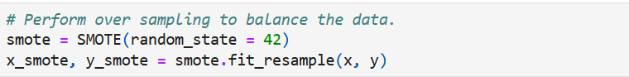
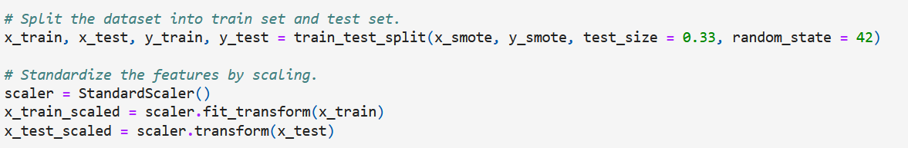
Model Development and Evaluation
Select features and target variables.
Perform oversampling.
Split the dataset.

Slide 22
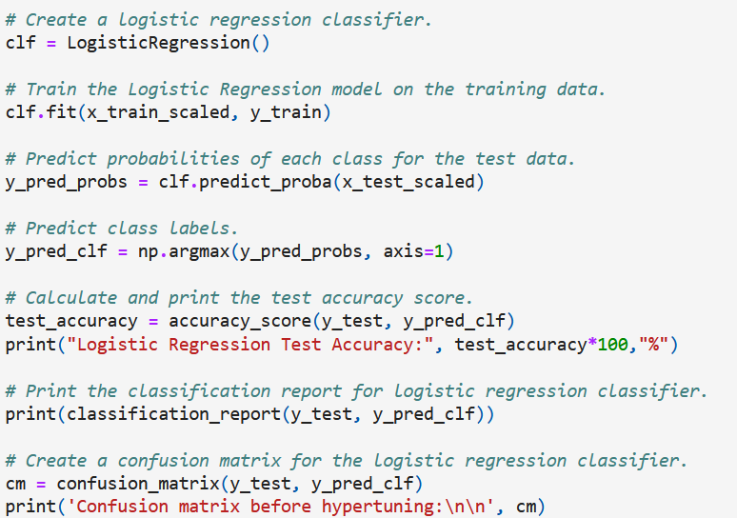
Model Development and Evaluation
Various models development.
Logistic Regression.

Slide 23
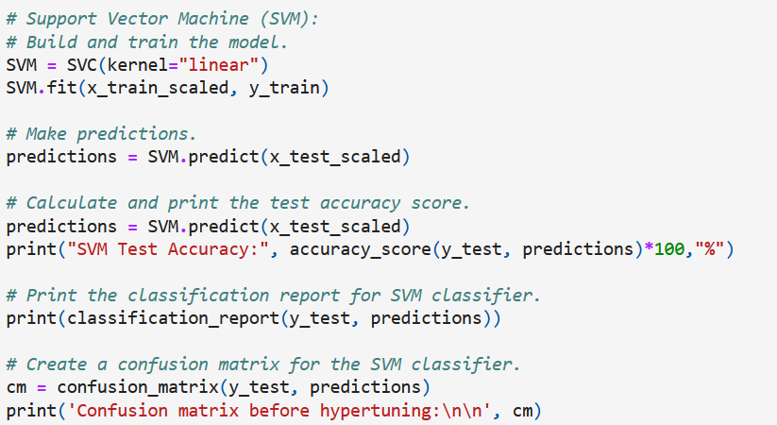
Model Development and Evaluation
Various models development.
Support Vector Machine (SVM).

Slide 24
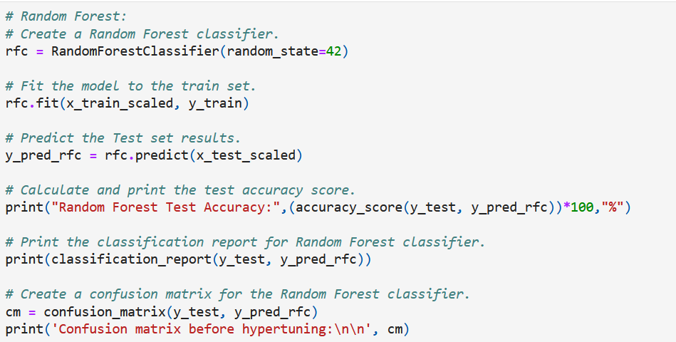
Model Development and Evaluation
Various models development.
Random Forest.

Slide 25
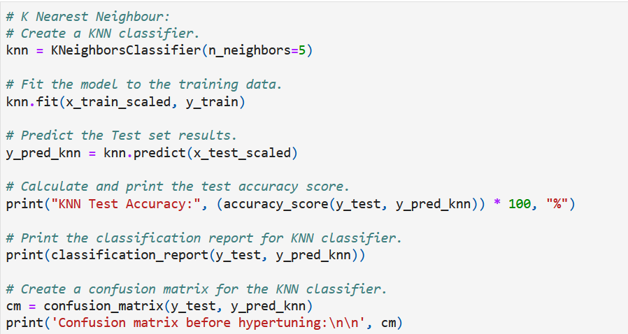
Model Development and Evaluation
Various models development.
K Nearest Neighbor (KNN).

Slide 26
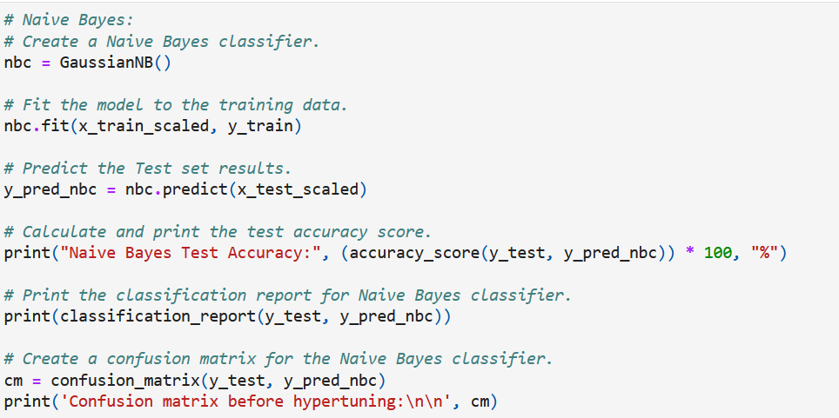
Model Development and Evaluation
Various models development.
Naïve Bayes.

Slide 27
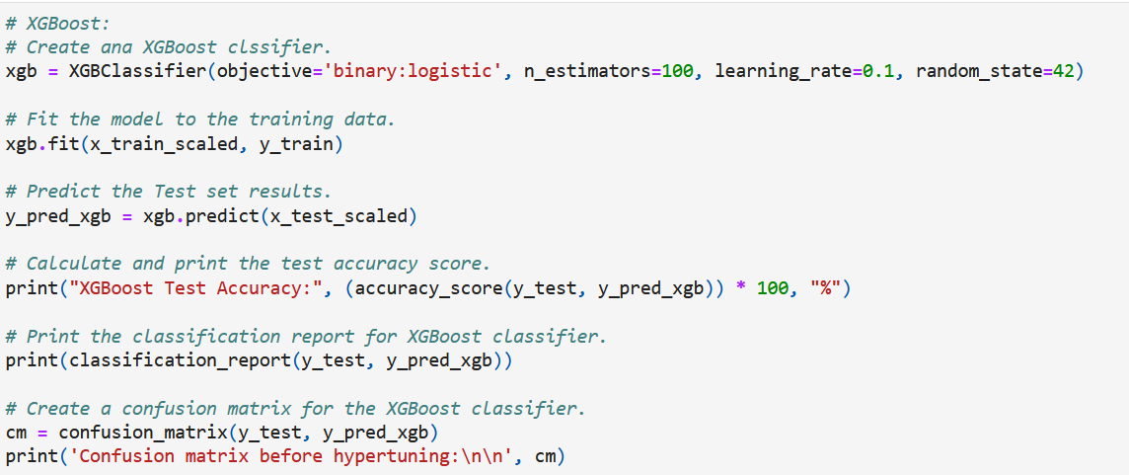
Model Development and Evaluation
Various models development.
XGBoost.

Slide 28
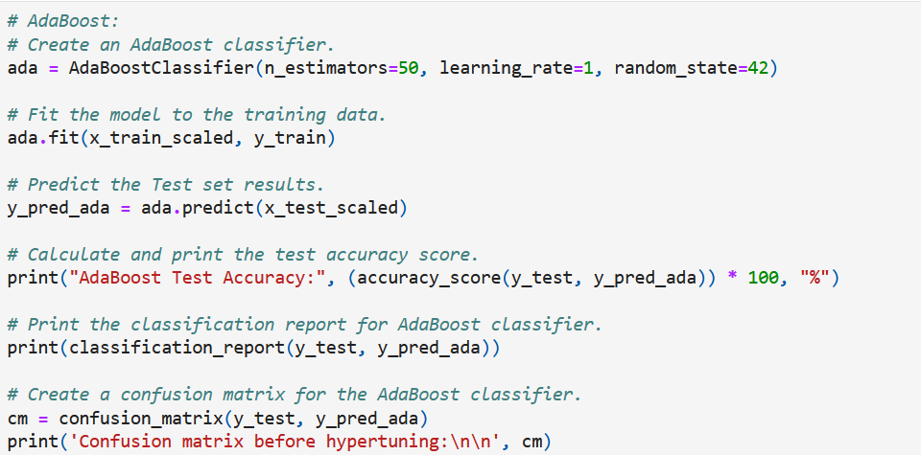
Model Development and Evaluation
Various models development.
AdaBoost.

Slide 29
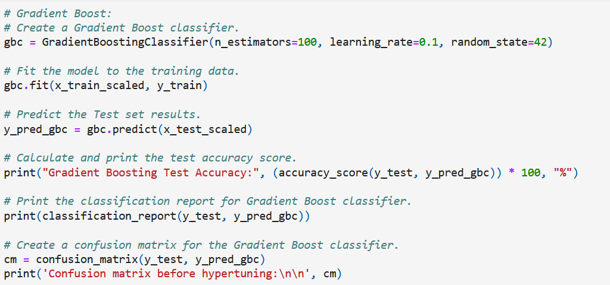
Model Development and Evaluation
Various models development.
Gradient Boost.

Slide 30
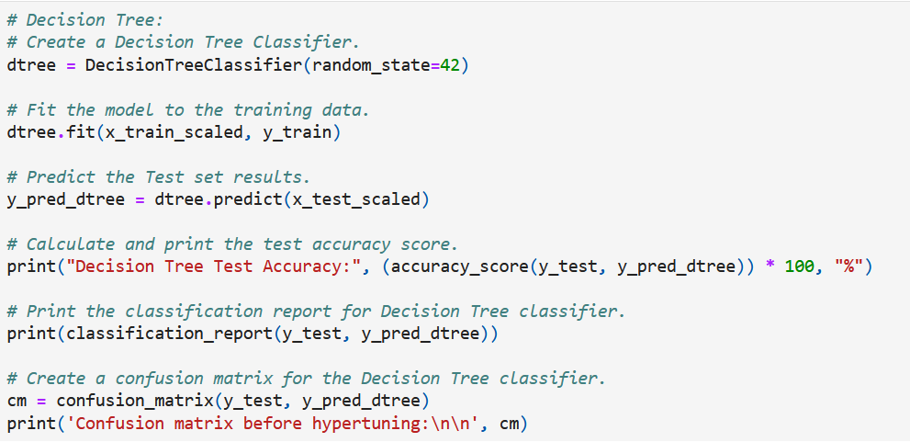
Model Development and Evaluation
Various models development.
Decision Tree.

Slide 31
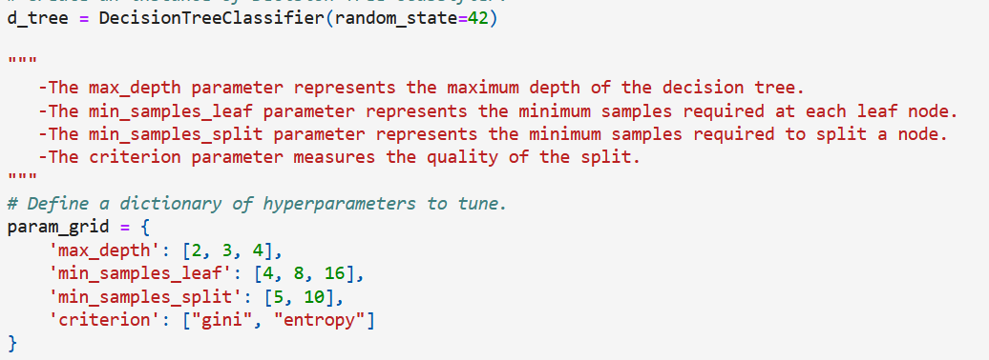
Hyperparameter Tuning
Create a dictionary of hyperparameters

Slide 32
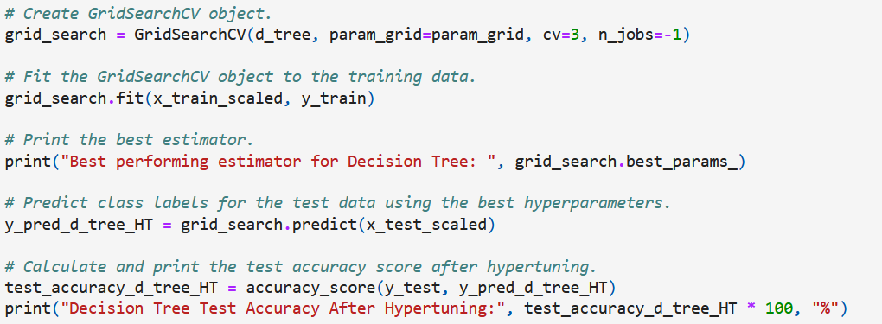
Hyperparameter Tuning
Create a grid search object, fit and predict.

Slide 33
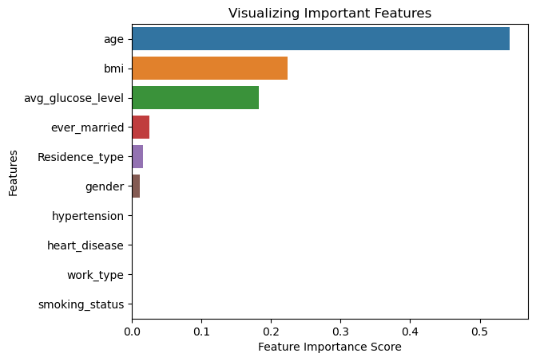
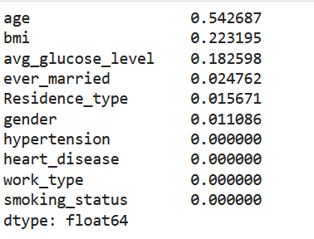
Feature Importance
Use Random forest model to visualize important features.

Slide 34
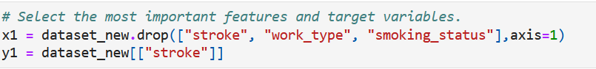
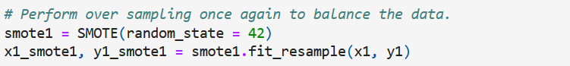
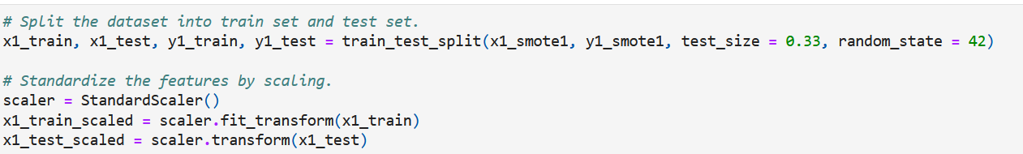
Retraining Models
Select features and target variables.
Perform oversampling.
Split the dataset.

Slide 35
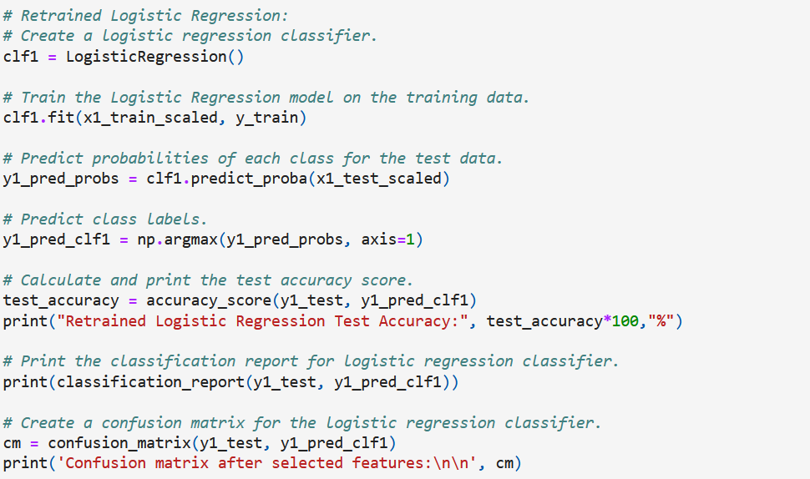
Retraining Models
Various models development.
Logistic Regression.

Slide 36
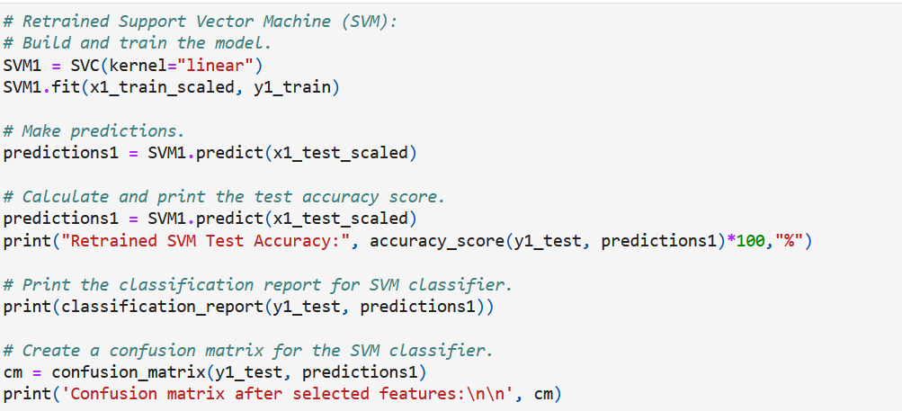
Retraining Models
Various models development.
Support Vector Machine (SVM).

Slide 37
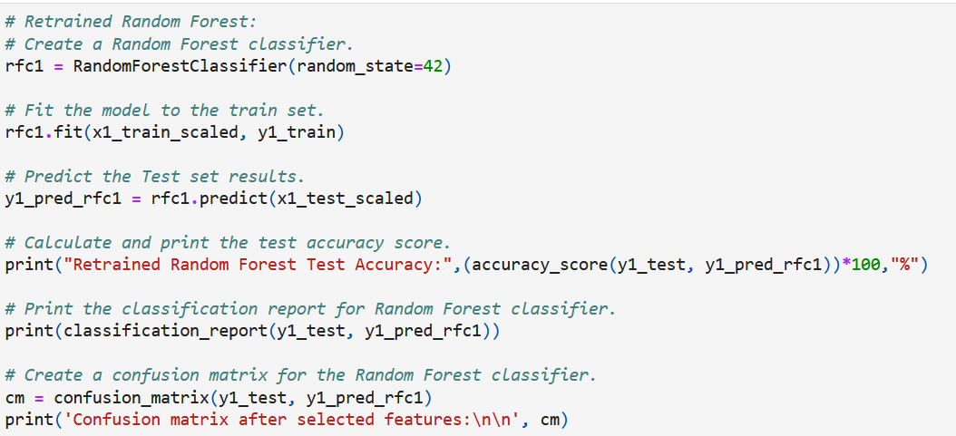
Retraining Models
Various models development.
Random Forest.

Slide 38
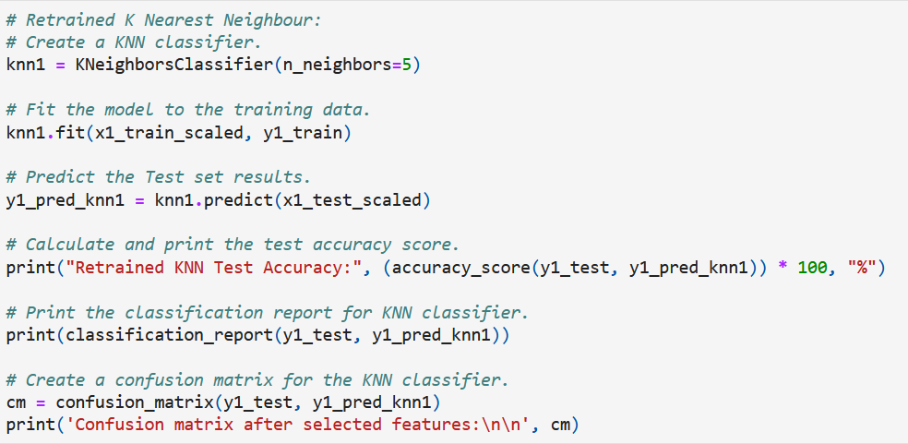
Retraining Models
Various models development.
K Nearest Neighbor (KNN).

Slide 39
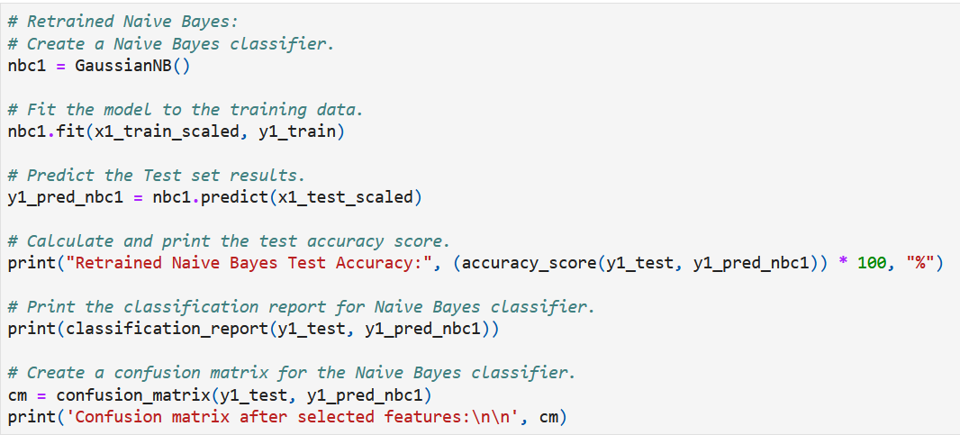
Retraining Models
Various models development.
Naïve Bayes.

Slide 40
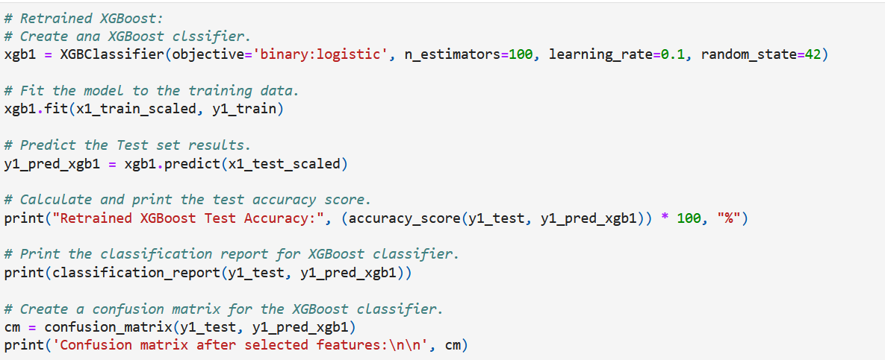
Retraining Models
Various models development.
XGBoost.

Slide 41
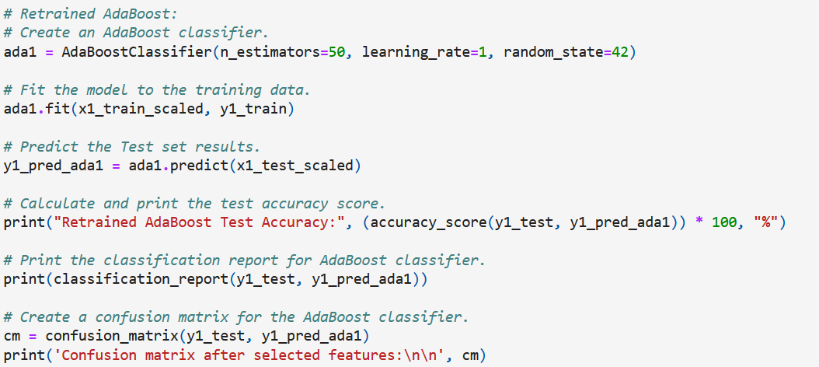
Retraining Models
Various models development.
AdaBoost.

Slide 42

Retraining Models
Various models development.
Gradient Boost.

Slide 43

Retraining Models
Various models development.
Decision Tree.

Slide 44

Model Deployment

Slide 45

Model Deployment

Slide 46

Model Deployment

Slide 47
03
Results

Slide 48


Model Development and Evaluation
Logistic Regression.
Support Vector Machine (SVM).

Slide 49


Model Development and Evaluation
Random Forest.
K Nearest Neighbor (KNN).

Slide 50


Model Development and Evaluation
Naïve Bayes.
XGBoost.

Slide 51


Model Development and Evaluation
AdaBoost.
Gradient Boost.

Slide 52

Model Development and Evaluation
Decision Tree (Best performing model).

Slide 53

Hyperparameter Tuning
Print the best parameters and accuracy,

Slide 54


Retraining Models
Logistic Regression.
Support Vector Machine (SVM).

Slide 55


Retraining Models
Random Forest.
K Nearest Neighbor (KNN).

Slide 56


Retraining Models
Naïve Bayes.
XGBoost.

Slide 57


Retraining Models
AdaBoost.
Gradient Boost.

Slide 58

Retraining Models
Decision Tree (Best performing model).

Slide 59

Model Deployment

Slide 60

Model Deployment

Slide 61


Model Deployment

Slide 62
04
Conclusion

Slide 63
Conclusion
Predict strokes outcomes based on patients’ information
Provide a tool that could enhance early detection accuracy, enable more effective treatment plans and patient outcomes.
The model achieved an accuracy score of 97.2% in predicting stroke occurrences.

Slide 64
05
Limitations

Slide 65
Limitations
Dataset imbalance.
Limited number of features (12).
Considerable number of null values and outliers.
Higher model susceptibility to overfitting.

Slide 66
06
Recommendations

Slide 67
Recommendations
Employing a variety of models and incorporating regularization techniques would help avoid overfitting.

Slide 68
Thanks!!
Any questions?

